Slide 1

Security and Ethics of AI use
Session 3

Slide 2
Recap of last session
AI Learns via Patterns: Systems process vast amounts of data to recognize patterns quickly and efficiently.
Strengths & Limitations:
Strengths: Speed, accuracy, consistency, and productivity.
Limitations: Bias, overreliance, and lack of contextual understanding or empathy.
Core Takeaway: Human Oversight Matters. AI is a powerful partner, but it requires human judgment to ensure its output is fair, accurate, and responsible.

Slide 3
Learning objectives
Use AI safely in your professional environment.
1
Protect sensitive and private data from leakage or misuse.
2
Recognize and mitigate common security risks.
3
Apply ethical principles to guide all AI interactions.
4

Slide 4
Can we trust AI?
This session addresses the Trust Problem that arises when using AI tools.
Key Questions:
Data Trust: When sharing information (customer details, internal documents), where does our data go, and how is it protected?
Output Trust: Can we trust the AI's output to be fair, unbiased, and transparent?

Slide 5
Data & privacy: risk of sharing
Definition of Sensitive Data: Information that, if exposed, could cause harm, violate laws, or damage reputation (e.g., PII, financial data, health records, trade secrets).
Examples of Sensitive Data Categories:
PII: Full names, SSNs, addresses, phone numbers.
Corporate: Internal strategies, trade secrets, financial forecasts.
Health Data: Patient records (violates HIPAA/GDPR).
The Bulletin Board Principle:
Treat all AI inputs as if you are placing the information on a public bulletin board. If it's sensitive, confidential, or regulated, do not share it.

Slide 6
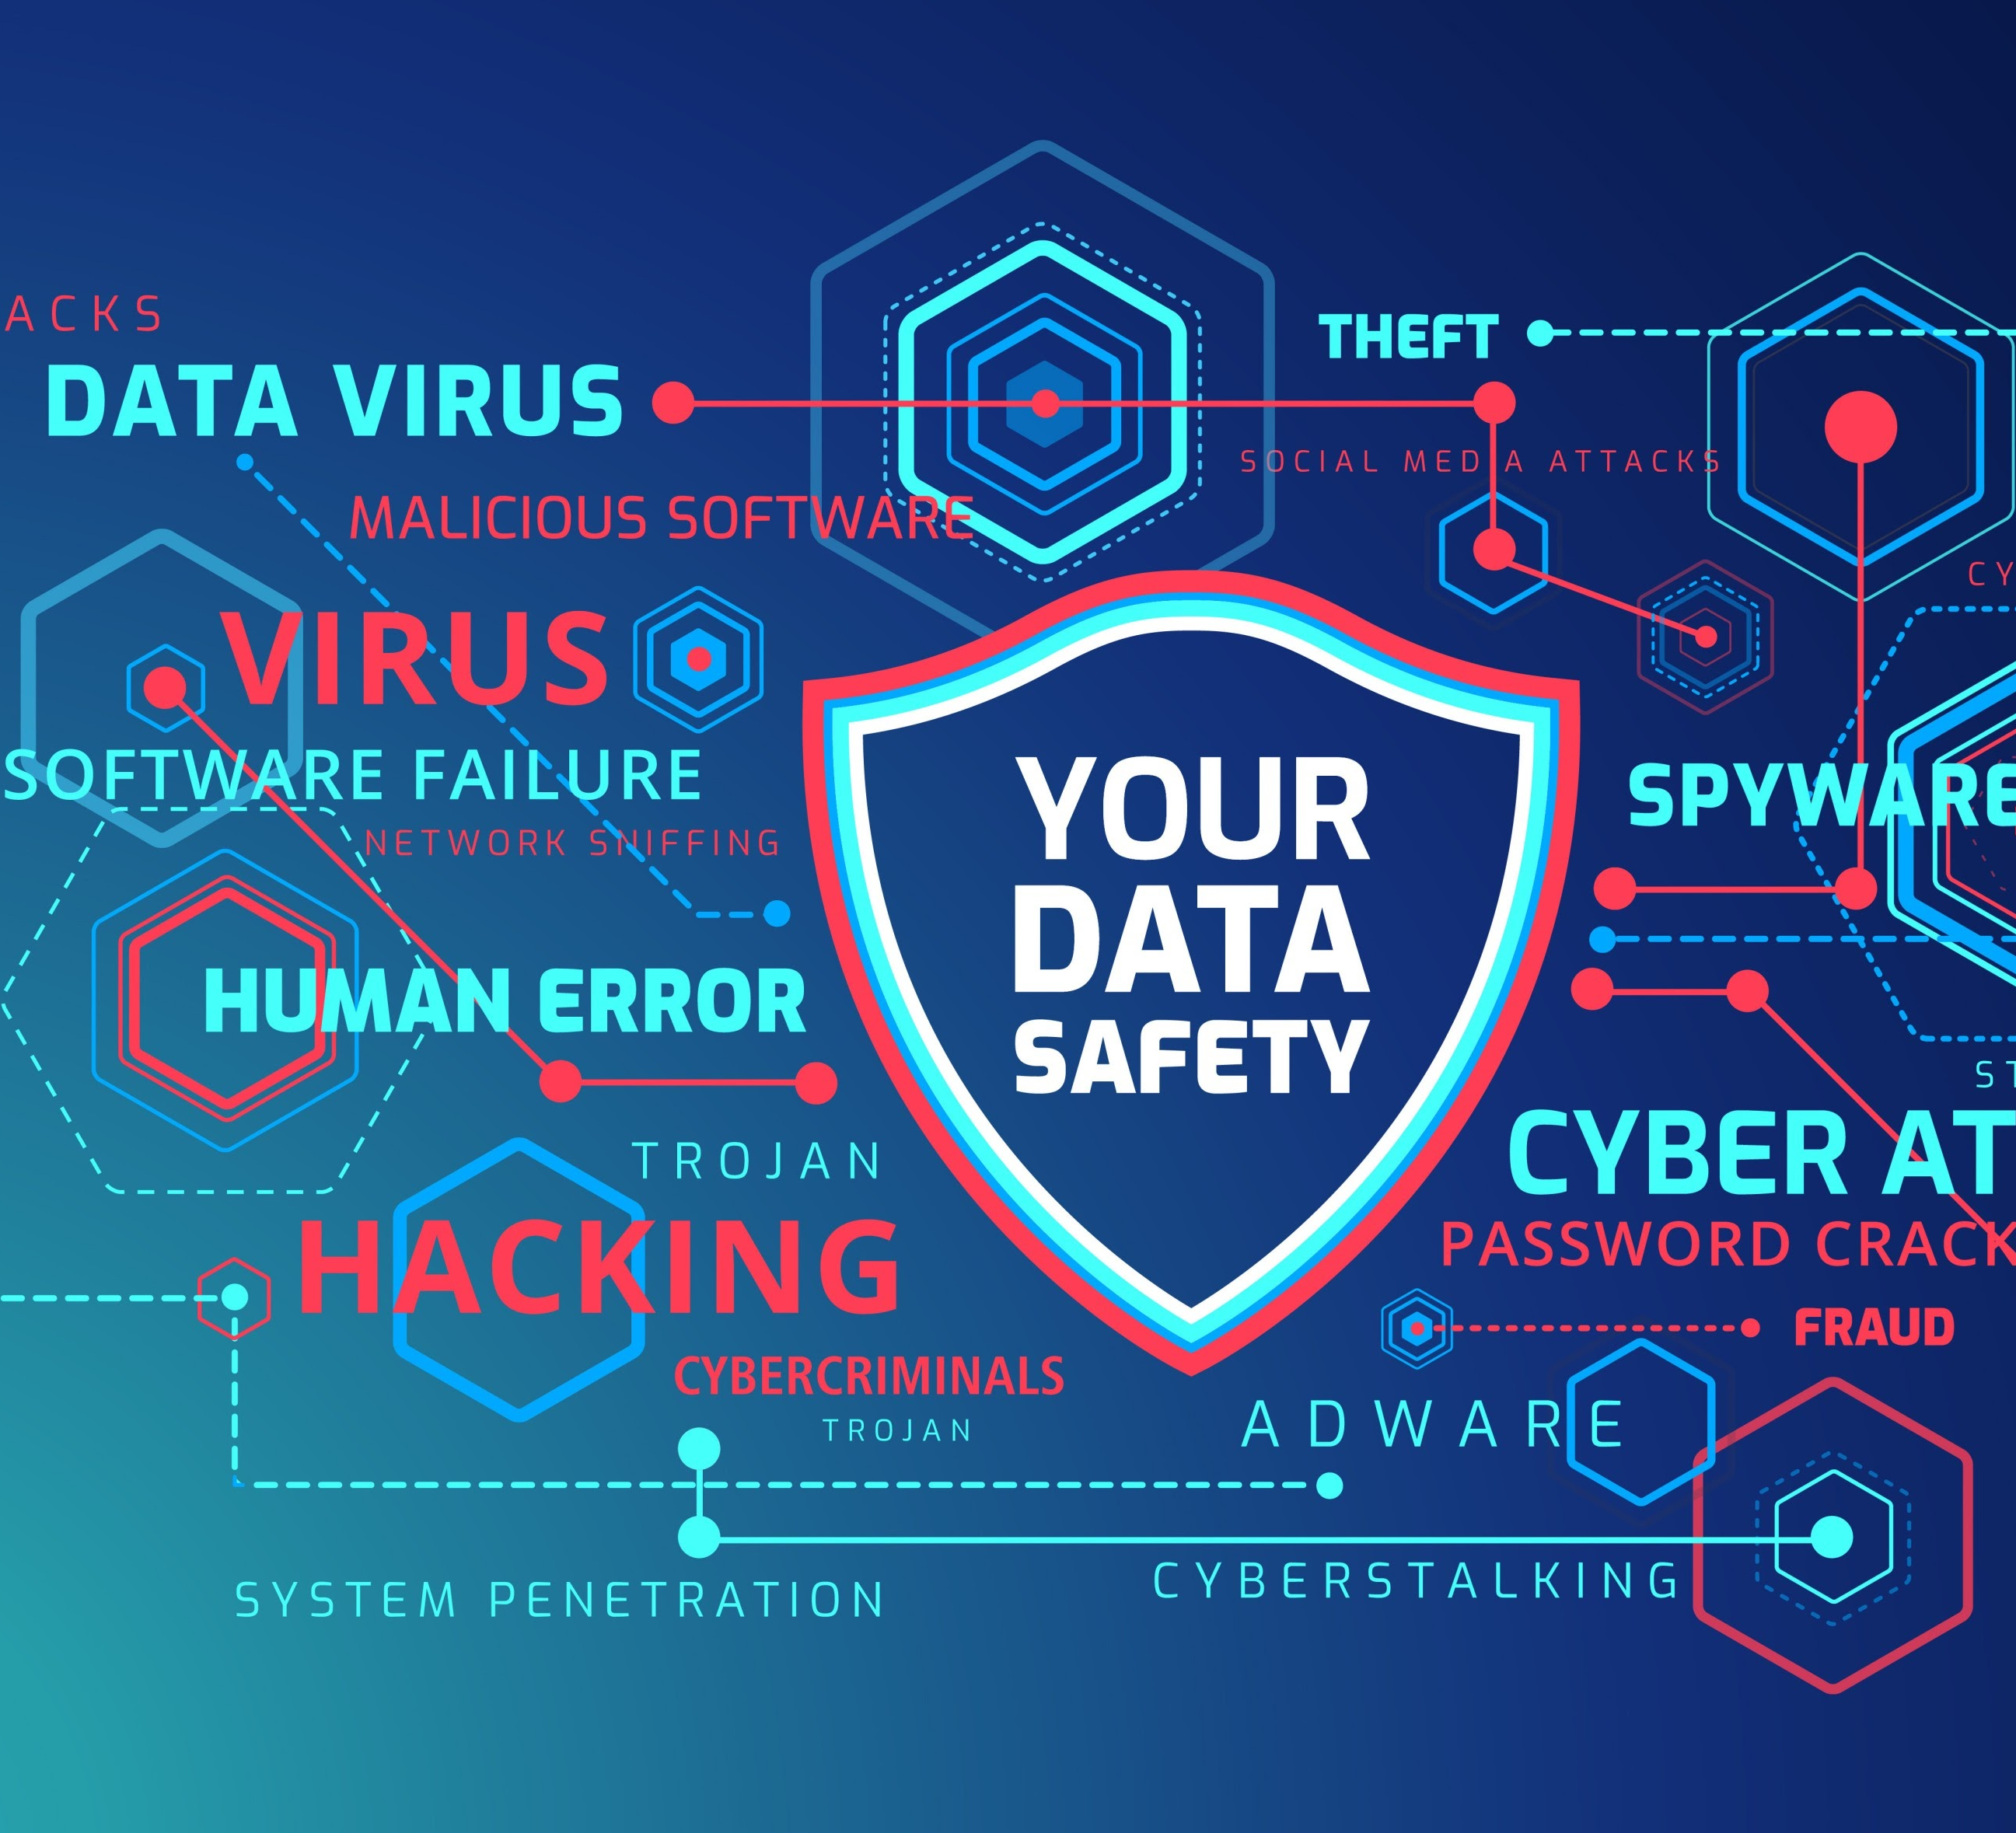
Risks of sharing data with AI
Unauthorized Access & Leakage: Data is stored on a cloud service you don't fully control. If the platform is hacked, sensitive information could be exposed.
Inference and Reconstruction: AI models can reconstruct or infer private details from data patterns, even if the information was initially "anonymized."
Legal and Regulatory Exposure: Sharing protected data (like health or financial records) can violate laws (GDPR, HIPAA), leading to fines and legal action.
Reputational Damage: A single data breach erodes trust with clients, stakeholders, and the public.
Core Takeaway: AI lacks discretion. Once sensitive data is shared, you lose control over who can see it or how it's used.

Slide 7
What Not to Share & Unintended Risks
Critical Information to Withhold:
Full names/contact details of clients or colleagues.
Passwords, PINs, or login credentials.
Financial data/bank account information.
Confidential legal or business documents.
Medical or personally identifiable health information.
Risk of Unintended Data Sharing:
AI can sometimes infer sensitive details from context, even if you don't name individuals or companies. Avoid providing any specific, identifying scenario

Slide 8
Real-world Case study: Cambridge analytica
Sequence of Events | Ethical Red Flags
1. Covert Data Harvesting: A harmless-looking Facebook quiz collected personal data (likes, locations, interests) from over 80 million users without informed consent. | Violation 1: Lack of Informed Consent
2. Psychological Profiling: Data was fed to AI models to build detailed psychological profiles, predicting voters' fears and political leanings. | Violation 2: Opaque Algorithms (The "Black Box" Problem)
3. Micro-Targeted Influence: These profiles were used to micro-target individuals with politically charged ads designed to influence major elections. | Violation 3: Amplification of Harm (Eroding trust in democratic systems)
Cambridge Analytica (2016): The Trust Failure
Key Takeaway for Professionals
Just because AI can use data, doesn't mean it should.
The Lesson:
Whether analyzing customer feedback or assisting with hiring, we have an ethical duty to ensure transparency, protect privacy, and prevent AI from crossing the line from helpful to harmful.

Slide 9
Practical Tips to mitigate data risks with AI
Secure the Input (Anonymize & Redact):
Remove identifiers or mask/replace sensitive details in documents and datasets before feeding data to AI.
Use Hypothetical Examples:
Create fictional cases instead of real, sensitive scenarios when testing or experimenting.
Check Tool Policies:
Always read the privacy policies. Know if the AI service stores inputs and outputs to train its model.
Limit to Secure Platforms: For regulated data (finance, legal, health), only use IT/Compliance-approved AI solutions.
Check before Using:
Ask yourself, "Would sharing this information cause harm if it were exposed?" If the answer is yes, do not share it.
Data Privacy is Shared Responsibility:
Individual judgment is key. Organizations must provide guidelines, but you are responsible for every disclosure.

Slide 10
Decision Risks
Decision-Making Errors: AI outputs (summaries, recommendations) can be inaccurate, biased, or incomplete but look highly plausible.
The Risk: Employees acting on unverified outputs can introduce mistakes into critical processes, leading to financial or reputational harm.
Tips: AI is a decision support tool, not a decision-maker. Always cross-check and validate outputs in context.

Slide 11
Automation risks
Automation Risks: Integrating AI into workflows allows for incredible speed, but also risks propagating errors quickly across departments or clients.
The Risk: A small AI mistake can rapidly escalate into a large operational problem because automation doesn't allow for human self-correction.
Tips: Requires regular human oversight, reviews, and approvals to ensure AI-driven workflows don't cause cascading failures.

Slide 12
Accountability issues
Accountability Issues: When AI supports decisions or automates tasks, it can become unclear who is responsible when things go wrong (e.g., a compliance violation).
The Challenge: Determining accountability among the AI developer, the user, and the organization creates ethical and legal challenges.
Solution: Define clear ownership for AI-assisted decisions. Maintain transparent documentation, ensuring a human reviews and takes responsibility for the final outcome.

Slide 13

Mitigating risks: overreliance & use-case
Most AI risks (errors, bias, automation failures) stem from trusting AI too much or using it carelessly.
Rule of Thumb: Use AI when the task is low-risk, repetitive, or easily verifiable. Avoid it when the decision carries ethical, legal, or human consequences.
Low-Risk: Generating meeting summaries, drafting initial emails. (High productivity, low cost of error).
High-Risk: Interpreting patient data, assessing employee performance, approving financial transactions without human review.
Mitigation Strategy: Human Oversight: No matter how sophisticated the AI, humans must remain the final checkpoint to apply context, verify outputs, and ensure compliance.

Slide 14
Mitigation: Scepticism and Transparency
Cultivate Healthy Skepticism: AI tools are persuasive by design; their confidence can mask inaccuracies. Pause and question the results (Ask: Does this make sense? Is it consistent?).
Need for Transparency and Boundaries: Teams must openly discuss how AI is used and agree on clear policies outlining what kinds of data, tasks, and decisions are appropriate for AI support.
The Foundation of Safety: Secure AI use is about discernment—knowing when to trust AI and when to take back control.
The Goal: AI becomes a partner that amplifies human capability, not a tool that quietly undermines your systems.

Slide 15
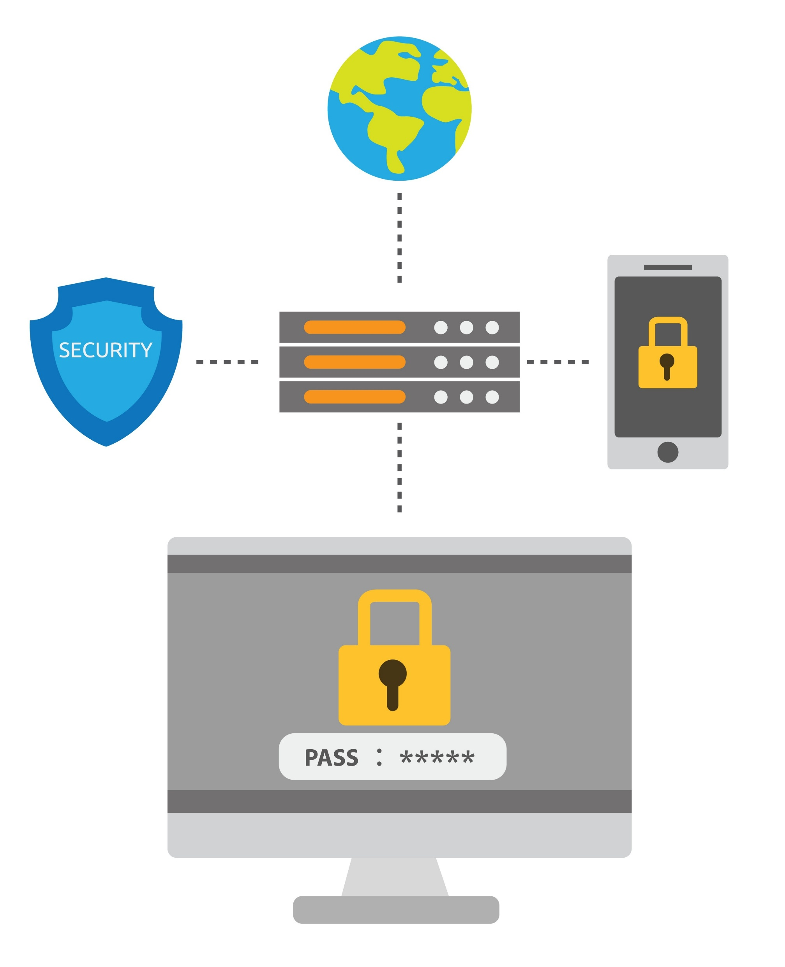
Summary
Data Security: Sharing PII or Proprietary Data with external AI risks leakage, regulatory fines, and competitive exposure.
Ethical Failure: Consequences of ignoring Informed Consent and relying on Opaque Algorithms (e.g., Cambridge Analytica).
Mandate: Accountability never transfers to the machine; the human user or organization is always responsible.
Mitigation: Discernment and Policy
Root Cause: The biggest risk is Overreliance—trusting the AI too much.
Individual Strategy: Practice Human Discernment (mentioned in session 2) by choosing low-risk, verifiable tasks. Avoid using AI for decisions with ethical, legal, or human consequences.
Organizational Strategy: Implement Clear Policies, establish Accountability Frameworks, and ensure continuous Verification and Training.
Final Principle: AI must assist human judgment, not decide for us

Slide 16

Confidentiality check - ACtivity
Please refer to the activity 3.1 instruction sheet

Slide 17
Worksheet activity

